Slide 1
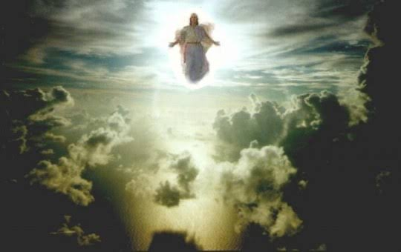
1 Thessalonians V
The Day of the Lord

Slide 2
Paul Notices Three Very Good Things In the Church in Thessalonica
1. Their work produced by faith.
2. Their laber prompted by love.
3. Their endurance inspired by hope in our Lord Jesus Christ.

Slide 3
1 Thess 2:7-12 We Are Family
We were like children among you.
We were like a nursing mother among you.
We were like a father among you.

Slide 4
1 Thessalonians 2:17-3:5
We were like orphans…
For what is our hope, our joy, or the crown in which we will glory in the presence of our Lord Jesus when he comes? Is it not you? Indeed, you are our glory and joy.

Slide 5
1 Corinthians 4:1-12
Avoid sexual immorality. Do not take advantage of a brother or sister (sexually)
Continue in brotherly love.
Make it your ambition to live a quiet life which will be an example to unbelievers.

Slide 6
1 Thessalonians 4:13-18
About end-times… The parousia lit. presence
Their issue? What about those who have died? Will they join us in the future resurrection?
Our issue: The “rapture,” the “tribulation,” Antichrist and the 1000-year reign of Jesus in Jerusalem. Dispensational Premilennialism.

Slide 7

Give Me the Details: What Will It Be Like?
v. 16 A trumpet sound. Matthew 24:31
The Feast of Trumpets rosh hashannah yom teruah
The dead in Christ will rise first, then those who are still alive will join them to lead christ in a triumphal procession to the transformed earth.

Slide 8
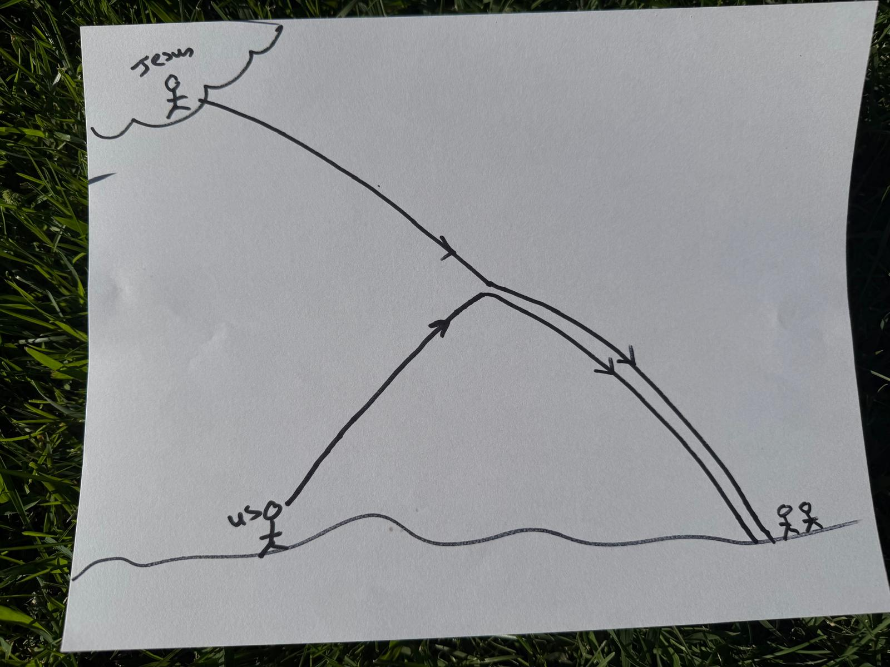
The language of 1 Thess 4 is of a royal procession.
Palm Sunday
The Coming of the Lord parousia

Slide 9
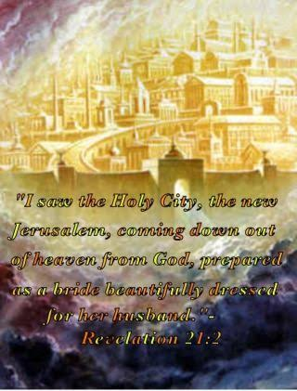
Are We Going to Heaven?
No! Heaven is coming to us.
Revelation 21:1-2

Slide 10
The Main Point
We have hope!
Why? Because of the resurrection of Christ, which is proof of our future resurrection.
Therefore, encourage one another with these words.

Slide 11
1 Thessalonians 5:1-11
Preparing for the Day of the Lord
Last week: What will happen when Jesus comes again?
This week: Therefore, how should we live?
Q: Which is more important to us?

Slide 12

1 Thessalonians 5:1 About Dates and Times…
Paul’s point: The date and time are not important!
Why? Because no one knows. It will come like a thief.

Slide 13
Sir Isaac Newton
The folly of Interpreters has been, to foretell times and things, by this Prophecy, as if God designed to make them Prophets. By this rashness they have not only exposed themselves, but brought the Prophecy also into contempt. The design of God was much otherwise. He gave this and the Prophecies of the Old Testaments, not to gratify men's curiosities by enabling them to foreknow things, but that after they were fulfilled they might be interpreted by the event; and his own Providence, not the Interpreters, be then manifested thereby to the world. For the event of things predicted many ages before, will then be a convincing argument that the world is governed by providence.[7]

Slide 14
The Day of the Lord
TDOL 26 times in OT
Is the Day of the Lord a good day? That depends.
Joel 1:15 Alas for the day!
Joel 2:1 Blow the trumpet!
Joel2:31 Apocalyptic language.
Joel 3:14 Multitudes, multitudes in the valley of decision…

Slide 15
The Day of the Lord
Suddenly, as labor pains on a pregnant woman.
Satan’s strategy is to distract us.
1. By overly focusing on the timing or the details. or
2. By getting us to ignore entirely that it is coming.

Slide 16
Why not worry about the times and dates?
1. Because nobody knows.
2. Because you should already be living as if it could come at any time.
1 Thess 5:3 While people are saying “peace and safety.”
Matthew 24:36-41 No one knows… not even the Son!
2 Peter 3:3-7 People will say, “Where is this coming?”

Slide 17
When Will Jesus Come?
“There is one thing certain about the timing of the Lord’s return, and that is that we cannot be certain about its timing.”
-Leon Morris

Slide 18
So, How Should We Live
We live in the shadow of the second coming of Christ.
1 Thess 5:4-8 Let us be awake and sober.
Matthew 24:42-44 Keep watch. Be ready for the Second Coming.

Slide 19
So, How Should We Live?
1. We should live as if Jesus were to come back today. Be ready.
And
2. We should live as if Jesus will not come back in the very near future.

Slide 20
So, How Should We Live?
2 Peter 3:10-14 Live holy and godly lives. Make every effort to be found spotless, blameless and at peace with Him.
1 Thessalonians 5:9-12 We are receiving salvation. Already but not yet. So…
Encourage one another and build each other up!
In Christ, You got this!

Slide 21
Summary
Do not worry about dates and times.
No one knows the day or hour, but TDOL will be a day of both salvation and of judgment.
Be ready. Be awake and sober. Live holy and godly lives.
Let us be encouraged and let us encourage one another about the second coming of Christ.

