Slide 1
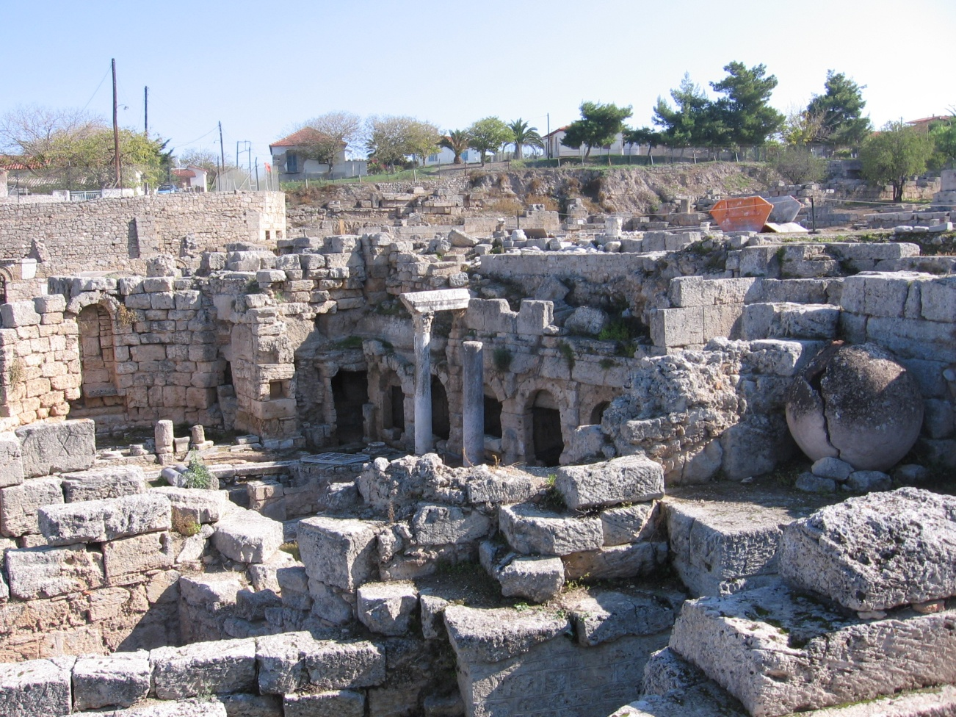
Acts 1:8 “You will be my witnesses to the ends of the earth”
The Marketplace in Corinth
How did they do it?
How can we do it?

Slide 2
Why Did They Change the World/
How Can We Change the World?
Acts 5:39
I. They knew Jesus. The personal effect of the man Jesus of Nazareth.
II. Powerful truth-claims.
Those two alone were not enough
to sustain a movement

Slide 3
Changing the World in Our Time
III. Moral/Ethical superiority of the Christians.
IV. They answered the hard questions. Intellectual superiority.
V. Christianity gave dignity to all people. Compassion
VI. Because God was with them (Acts 5:39)

Slide 4
I. The Life of Jesus: Knowing Jesus
Acts 4:12-13 They took note that they had been with Jesus.
Why was Paul transformed? Acts 9:1-16
We need to meet Jesus on our road to Damascus (Or on Pomerado Road)

Slide 5
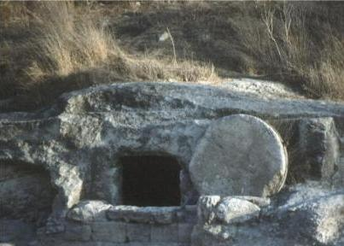
II. Powerful Truth Claims
Acts 2:22-24
  Jesus fulfilled OT prophecies
  Jesus worked signs, wonders and miracles
  Jesus was raised from the dead
Acts 26:24-27 True and Reasonable

Slide 6
According to the Old Testament, the Messiah must:
Be born in Bethlehem
Be raised in Galilee near Nazareth
Be despised and rejected by men
Be meek and silent before his accusers
Be “pierced”
Be crucified
Have his garments divided and gambled over
Be betrayed for 30 pieces of silver
Come to Jerusalem to make atonement for sin in about AD 30
And many more….
Notes:
6

Slide 7
III. Ethically and Morally They Were
Very Different. We need to be as well!!
Acts 17:5-7 Turned the world upside down.
Acts 19:17-20 Confronting the world and its ways. Sorcery
Acts 19:23-41 They confronted idolatry
Us today? Our constitution Matthew 5-7
Our Bill of Rights 1 Corinthians 9

Slide 8
“To them, every foreign country is like a Fatherland, and every Fatherland is like a foreign country.”
Their peculiarity is not their strange clothes or lack of use of technology; their strangeness is their embrace of an ethic the world considers nonsense.
Ex. Galen
“Their teaching of rewards and punishment in a future life led to a lifestyle not inferior to that of genuine philosophers. This is especially notable in their restraint in cohabitation, self-control in matters of food and drink and keep pursuit of social justice.”

Slide 9
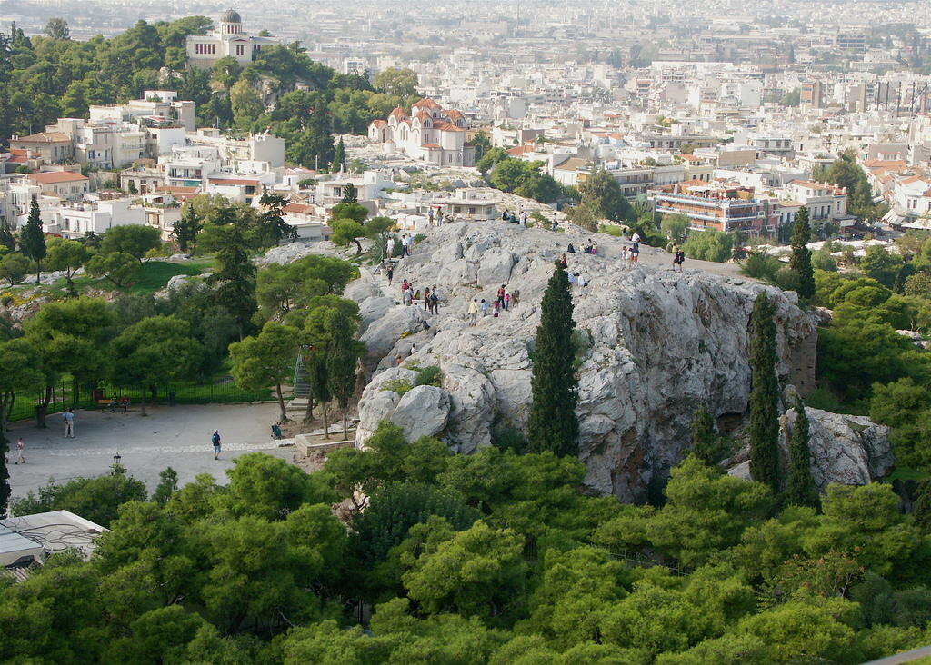
IV. Engage the World Intellectually With the Christian World View
Acts 17:16-34
Paul in Athens
We need to confront the enemy in the Areopagus and in the Lecture Hall of Tyrannus
The Areopagus in Athens

Slide 10
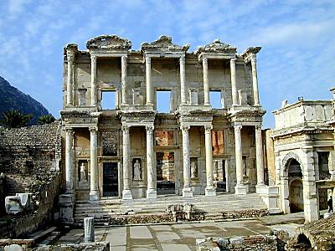
The Lecture Hall of Tyrannus

Slide 11
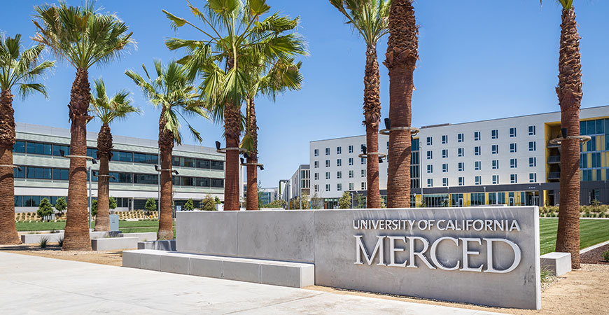
The Lecture Hall of UC Merced

Slide 12
Acts 17:16-34 Paul confronts Greek World Views
God is Creator. He exists outside creation.
  Disproves pantheism/Stoicism.
God is close to us.
  Disproves deism/Epicureanism.
God is personal and has given us an individual purpose.
God will bring all of us to judgment. Evil will be defeated
  Disproves dualism/Gnosticism.

Slide 13
V. The Church Met Needs/We Need to Meet Needs
Acts 2:44-45 All the believers were together and had everything in common. Selling…
Acts 3:6-10 Silver and gold we do not have, but what we have we will give. In the name of Jesus, get up and walk. What a testimony. We do not have much but what we have we will freely give.
Acts 4:32-35 All needs were met.
Acts 5:12-16 Meeting needs, healing.

Slide 14
Christians Meet the Needs of those Society ignores.
Christianity’s answer to suffering: Compassion. Jeremiah 22:15-16, James 1:27
Matt 9:35-38

Slide 15
Julian “the apostate.” (332-363)
“Atheism (i.e. Christian faith) has been specially advanced through the loving service rendered to strangers, and through their care for the burial of the dead. It is a scandal that there is not a single Jew who is a beggar, and that the godless Galileans care not only for their own poor but for ours as well; while those who belong to us look in vain for the help that we should render them.”

Slide 16
VI. If God is With Us….
Acts 5:38-39
With God’s help, they did it. They conquered the world. With God’s help, so can we.

