Slide 1
A Question….
What is the most common word or expression used in the New Testament for a person who is saved?

Slide 2
A Question….
What is the most common word or expression used in the New Testament for a person who is saved?
Saved?
Christian?
Disciple?
Forgiven?

Slide 3
The Answer….
In Christ
In Christ, in Him, In the Lord 164 times in Paul alone.

Slide 4

You Were Outside of Christ
Ephesians 2:1-3
Dead
Gratifying the flesh
Objects of wrath
Ephesians 2:11-12
Separate from Christ and excluded.
Foreigners
Without hope and without God
HOPELESS

Slide 5
Into Christ
You were dead. You were outside of Christ.
But something changed. Now you are In Christ.

Slide 6

If We are in Christ, How and when did we get into Christ?
Gal 3:26 Baptized into Christ
Romans 6:4 Baptized into Christ
Believe into Christ?
Repent into Christ?
Pray into Christ?
How do you get in there?
You were out here

Slide 7
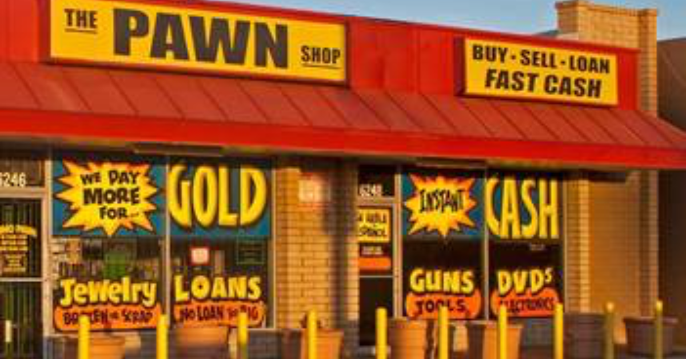
So… What do we have in Christ?
Coll 1:14, Eph 1:7 Redemption in Christ
Redeemed: Bought back
Illustration: A Pawn Shop
John 8:34-35
Hosea 2:5, Hosea 3:1-3
1 Cor 6:20 bought at a price

Slide 8
Holy/Saints In Christ!
Philippians 1:1 Holy in Christ Jesus
1 Cor 1:2 Sanctified in Christ—set apart for God’s use
2 Timothy 2:20 …a vessel for noble purposes
Holy, Holy Holy Isaiah 6:3, Revelation 4:8

Slide 9
Already But Not Yet
We were made these things.
We are being made these things.
We will be made these things.
We have been made holy.
We are being made holy.
We will be made holy.
God sees us as he is making us!!!!!!

Slide 10
Righteous in Christ
Mark 10:17-19 No one is good.
Romans 3:9-12 No one is righteous; not even one.
God made him who had no sin to be sin for us, so that in him we might become the righteousness of God. (2 Corinthians 5:21)
Challenge: Let us become what he has made us: Let us live righteously.

Slide 11

Alive in Christ
Eph 2:1-4 You were dead in your sins, but God made you alive.
Romans 6:8-11
1 Corinthians 15:20-22
Challenge: What are you going to do with the second chance that God has given you?

Slide 12
Summary
Have you come into Christ in baptism? Good!
If not, let’s go into the changing room and prepare to put on Christ
If so, then let us rejoice!!!
You are Redeemed in Christ!
You are Sanctified/Holy in Christ!
You are Righteous in Christ!
You are Alive in Christ!

