Slide 1

Let’s Stay Together
Oh, baby,
Let’s stay together (gether)
Lovin’ you whether, whether
Times are good or bad,
Happy or sad
What a great goal!
But we can do better than
That
Let's Stay Together

Slide 2
Our outline
Serve One Another
Accept One Another
Bear With One Another
Forgive One Another
Love One Another
Submit to One Another
Encourage One Another

Slide 3
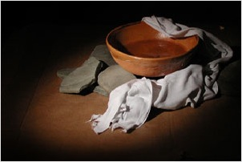
John: Serve One Another
Gal 5:13 You, my husbands and wives, were called to be free, but do not use your freedom to indulge the flesh, rather serve one another humbly in love.
Acts 20:35 Better to give than receive

Slide 4
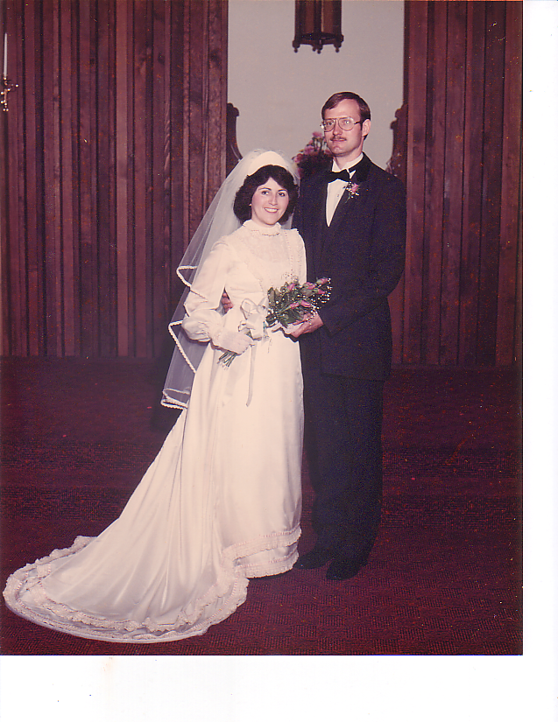

Slide 5

Serve One Another

Slide 6

Accept One Another
Rom 15:7 (in debatable matters) Accept one another, then, just as Christ accepted you in order to bring about praise to God.
(and a much happier marriage)

Slide 7
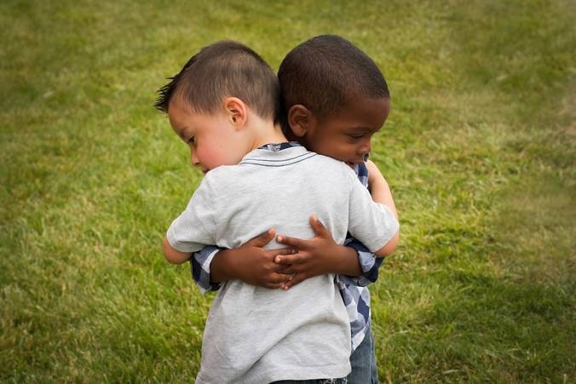
Accept One Another

Slide 8
Bear With One Another
Col 3:12-13 Therefore, as God’s chosen couple, holy and dearly loved, clothe yourselves with compassion, kindness, humility, gentleness, and patience. Bear with each other and forgive one another if you have any grievance against your spouse.

Slide 9
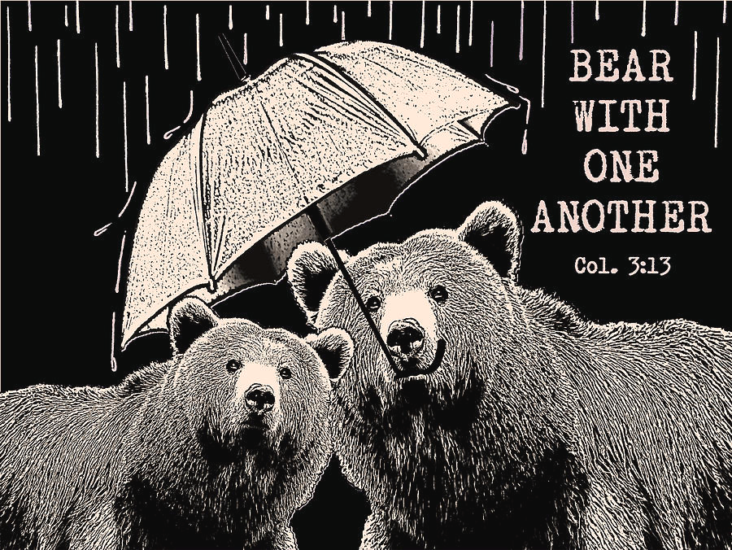
Bearing With One Another

Slide 10
Forgive One Another
Col 3:13 Bear with one another and forgive one another if any of you has a grievance against your spouse. Forgive as the Lord forgave you.
Matthew 18:21-34 The Parable of the unmerciful servant. I do not want to be that guy!

Slide 11

Forgive One Another

Slide 12
Love One Another
John 15:12-13 My command is this: Love each other as I have loved you. Greater love has no one than this: to lay down one’s life for one’s spouse.
Phil 2:3 In humility, value your spouse above yourself.

Slide 13

Love One Another

Slide 14
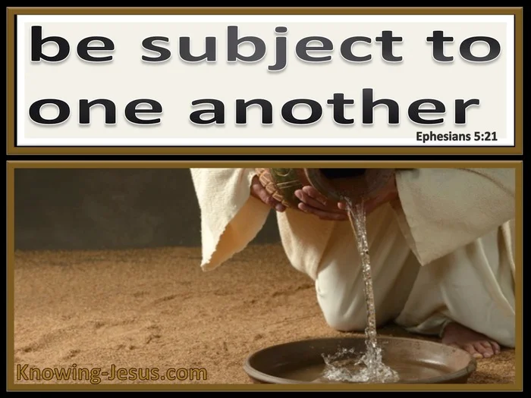
Submit to One Another
Ephesians 5:21 Submit yourselves one to another out of reverence for Christ.

Slide 15

Submit to One Another

Slide 16

Encourage One Another
1 Thess 5:11 Therefore, encourage one another and build up each other, just as (I hope) you are doing.
Encourage parakaleo to call alongside
Build up oikodomeite to give strength to

Slide 17

Encourage One Another

